Slide 1

Internet Health Report
Romain Fontugne
IIJ Research Lab
2023-05-03

Slide 2



IHR vision
An observatory for the Internet
Monitor & document Internet topology, evolution, and sudden changes
Open data / open source

Slide 3
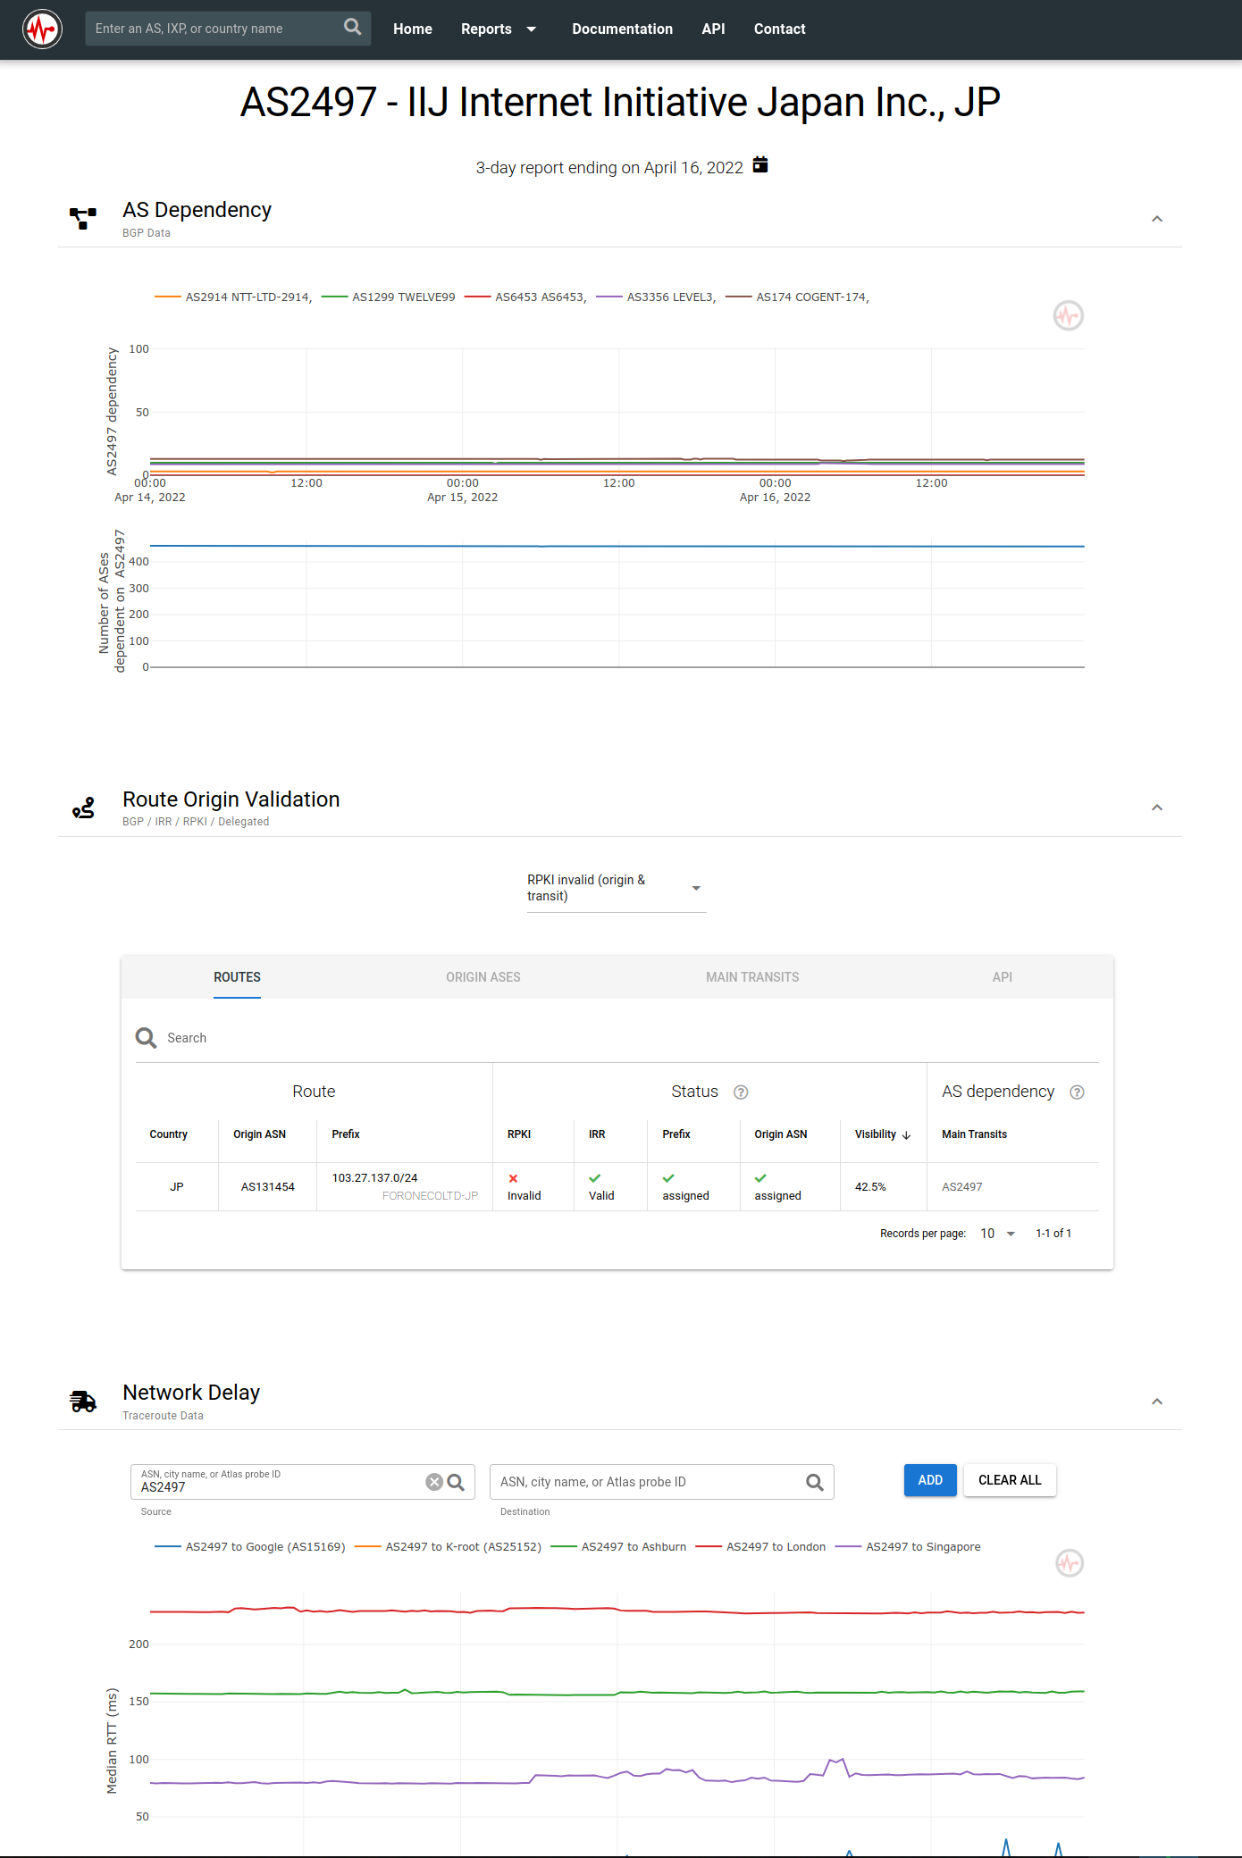











Monitoring the Internet
Open data
- BGP - traceroute - RPKI
Analysis modules
- Network dependency
- Network latency - Disconnections - Anomaly detection
Outcomes - https://ihr.iijlab.net
- Visualization
- API
- Daily dumps
- External collaborations / tools

Slide 4
Network dependency (AS Hegemony)
AS4
Measure AS inter-dependencies
Using BGP data
Give a good idea of the 'topological location' of ASes
Customers of an AS
Example: https://ihr.iijlab.net/ihr/en-us/networks/AS2501
AS3
AS2
AS1

Slide 5
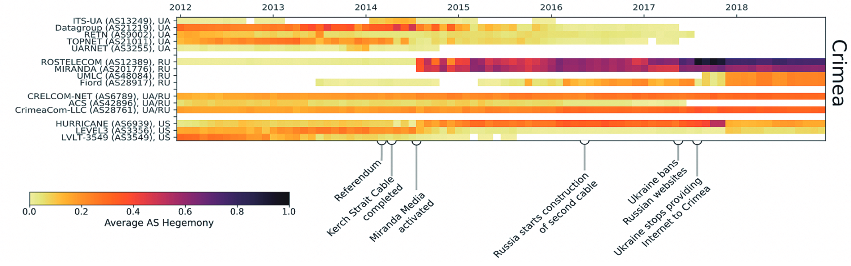
Network dependency variants
Regional bottleneck (e.g. Crimea)
Countries' AS dependency:
https://ihr.iijlab.net/ihr/en-us/countries/JP
BGP leak/hijacks, routing anomalies, AS ranking, consolidation, bottlenecks, peering
Rogers outage: https://twitter.com/ihr_alerts/status/1545789981603823616

Slide 6
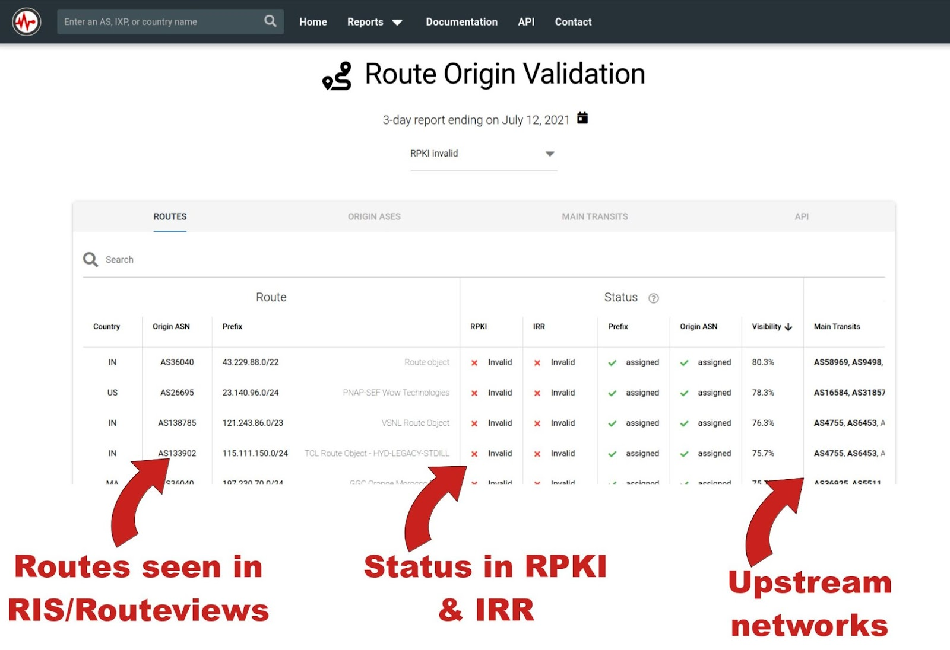
RPKI
Convey operators' intent
Trust (Public Key Infra.)
Route Origin Authorization (ROA)
AS15169 is authorized to announce 8.8.8.0/24
IHR monitors operators' intentions (RPKI) and actions (BGP)
Global view: https://ihr.iijlab.net/ihr/en-us/rov
Country-wide view: https://ihr.iijlab.net/ihr/en-us/countries/JP
Per AS: https://ihr.iijlab.net/ihr/en-us/networks/AS22822

Slide 7
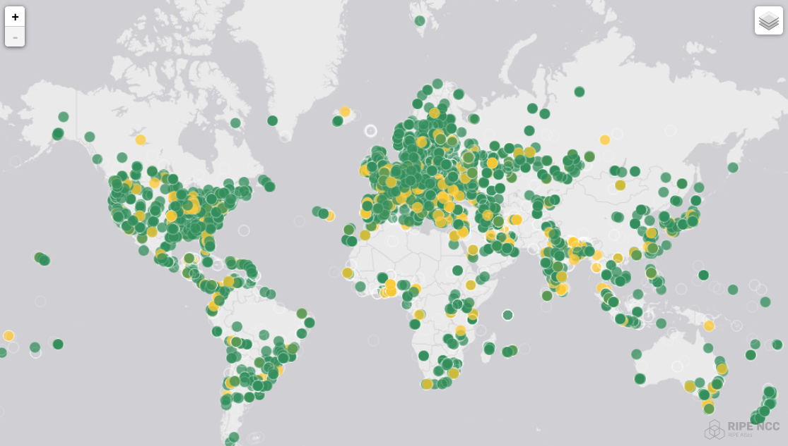
Network delays
RIPE Atlas (12k probes) Tons of traceroutes to several destinations
IHR monitors latency between Atlas probes and ASes/IXPs/cities/countries found in traceroutes
Examples:
Impact of subsea cable cut: https://twitter.com/DougMadory/status/1447659550975406094
Impact of COVID lockdowns: https://ihr.iijlab.net/ihr/en-us/covid19?country=France
War in Ukraine: https://twitter.com/ihr_alerts/status/1501446740498841604

Slide 8
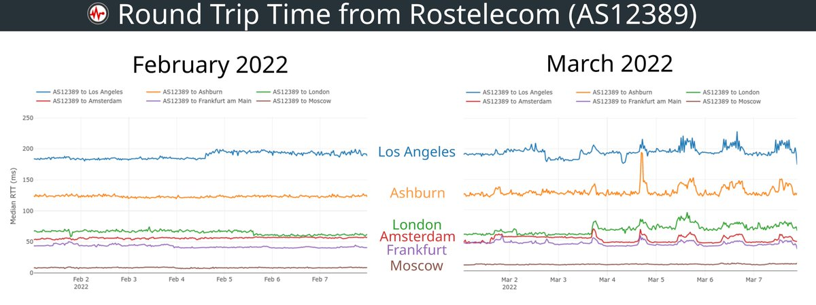
Network congestion

Slide 9
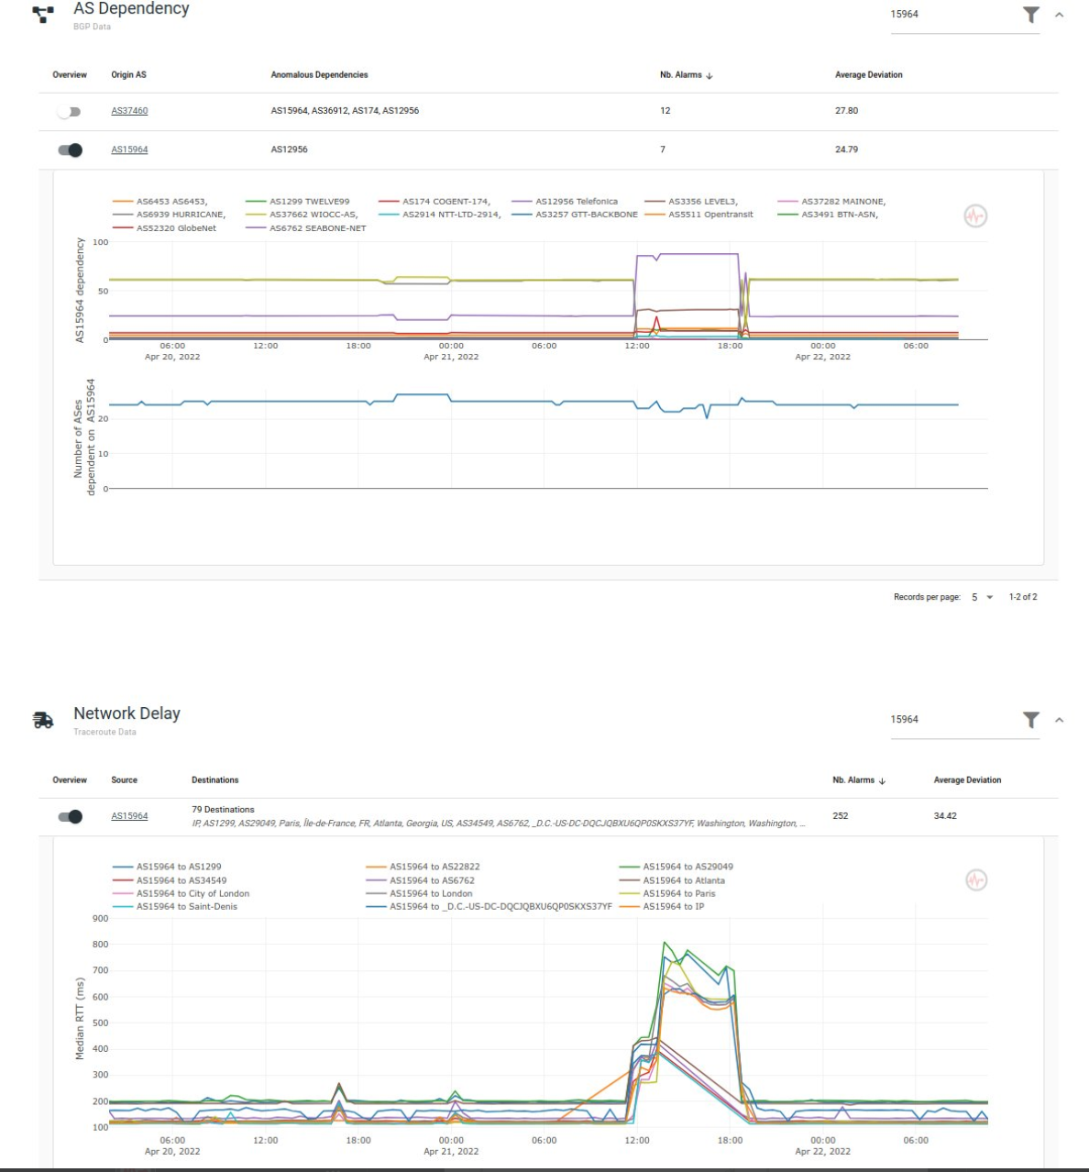
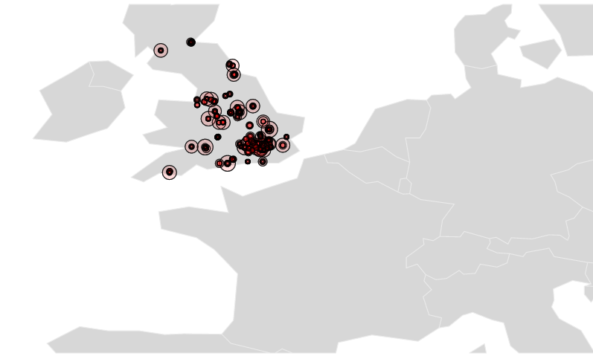
IHR Anomaly detectors
Disco
Outage detection
Based on RIPE Atlas
Virgin Media outage
Route, delay changes
Global report

Slide 10
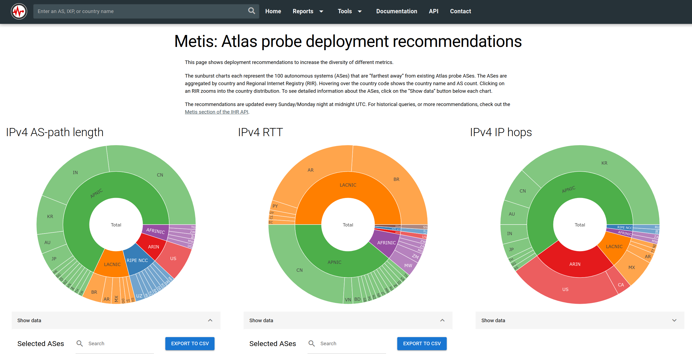
Metis: Probe selection/placement
Select a diverse set of Atlas probes?
Where to place new probes?
https://ihr.iijlab.net/ihr/en-us/metis

Slide 11
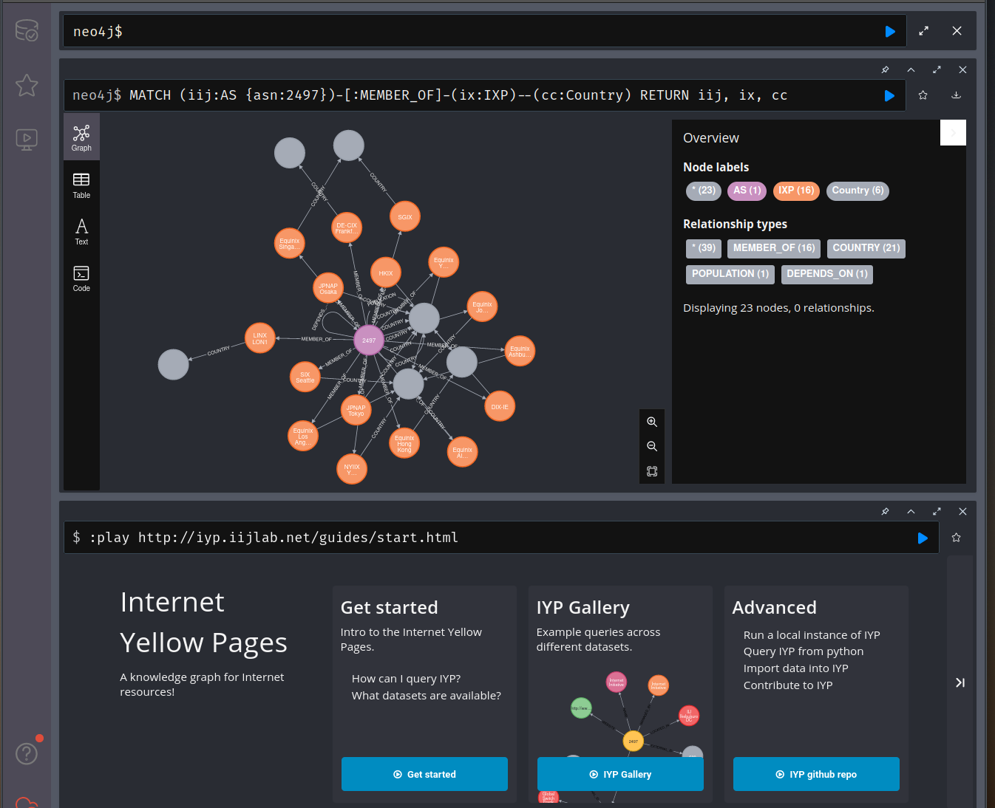
Internet Yellow Pages
Knowledge graph for networking data
13 data sources:
APNIC, BGPKIT, Bgp.tools, CAIDA, Citizen Lab, Cloudflare, IHR, MANRS, OpenINTEL, PeeringDB, RIPE NCC, NRO, Tranco
Semantic: 18 node types, 21 link types
About 4M nodes, 20M links

Slide 12
References
IHR: http://ihr.live
Github: https://github.com/InternetHealthReport
IHR daily dumps: https://ihr-archive.iijlab.net
Yellow Pages: https://github.com/InternetHealthReport/internet-yellow-pages/
romain@iij.ad.jp @ihr_alerts

Slide 13
IYP Tutorial
Crash course to cypher/neo4j
Overview of IYP datasets
Discuss applications
(local install, how to import your data)

